Slide 1
Cloth: Team Elephant
Jeffrey Oduro
Ondra Chan
Aaron Tse
Kevin De Asis

Slide 2
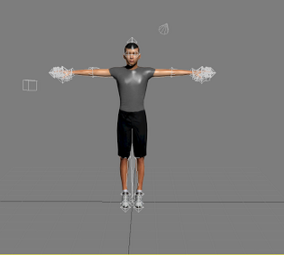
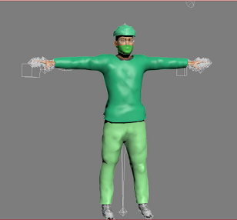
The Emperor Wears No Clothes

Slide 3
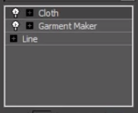
3 Modifers

Slide 4
Quick Start
Create a silhouette of your garment using lines
Make a copy of it and attach the original
Select all vertices and click break under geometry
Add garment maker modifier
Rotate one of your panels to a complete 180 and put them behind your model
Click individual lines that are parallel and create seams
Increase tolerance for seams if not symmetric

Slide 5
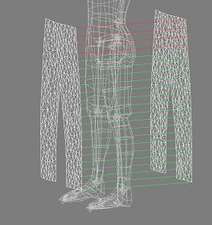
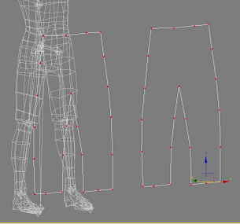
It should look like

Slide 6
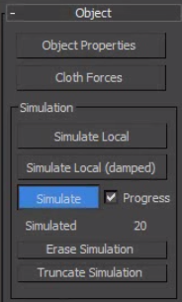
Simulation
Uncheck sewing springs
Under simulation properties
Click the set of vertices
For each seam and weld them
Easiest way to animate is
To turn it into a skin modifer

Slide 7
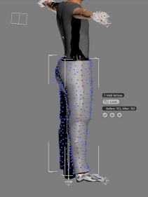
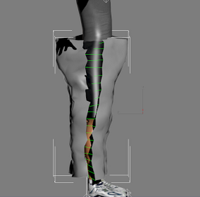
Finishing it off

Slide 8
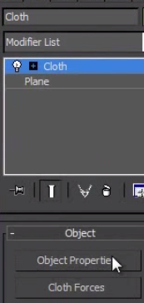
Cloth Modifier

Slide 9
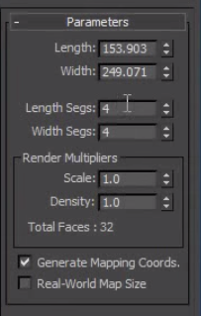
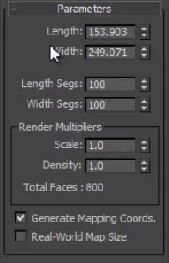
Realism of Cloth
Does anyone see the difference?

Slide 10
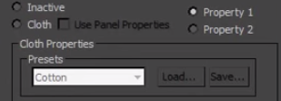
Object Properties

Slide 11
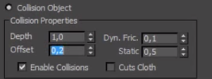
Object Properties

Slide 12
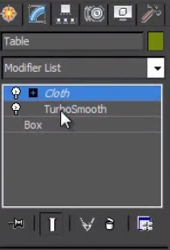
Preventing Paper Cuts

Slide 13
Video
http://youtu.be/xeC1A8T8Lqw

Slide 14
Reference
https://www.youtube.com/watch?v=MEsRmPgmt-I
https://www.youtube.com/watch?v=7ccxNRmakY4

